Slide 1
AI in Video Games

Slide 2
Video Games
Popular in modern day, everyone has played video games at least once
You have an objective, complete it

Slide 3
Evolution of Video games
python autograder.py -q q3
Objectives: Linear -> Linear and Dynamic
This means the goals in a games can be spread out; you can do a lot more while still having a main plot or main objective
Game Variety:
Developers have gotten more creative in producing games
Aesthetics:
Many games in modern era will monetize using aesthetics in the games
Etc:
- Things like Hitbox, projectiles, etc etc

Slide 4
So what is AI in video games
The objective,
the enemy,
the ally,
literally anything.

Slide 5
Watch video

Slide 6
AI in business
MMORPG has Bosses, Bosses mean content, content means money
MMORPG has Side objectives, Side objectives means difficulty, difficulty means automation

Slide 7
Money
Square Enix generates 42 billion yen
Some bot in a game
7 days = $7
10 days = $9
20 days = 14
30 days = 17
60 days = 31
90 days = 42
180 days = 65
360 days = 100

Slide 8
Issues
The bots
- Too much automation
- Too much spam
- More bots than there are actual players
- Unfair advantages, pay to win??

Slide 9
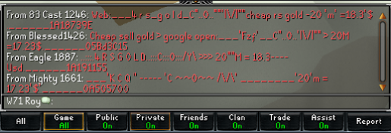

Slide 10
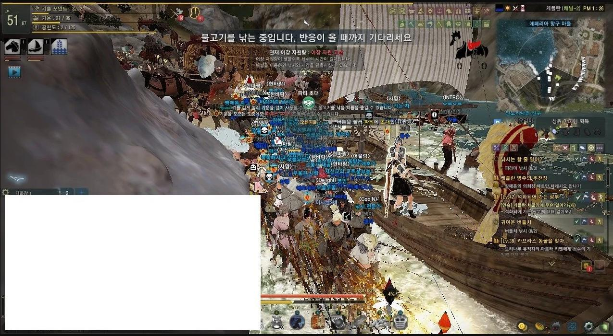

Slide 11
Ethics
The person who creates the bot
Should he care or should he not? he needs the money, so he sells his product
Ruin game for many others or live nicely
Person who uses the bot
Should he care or not?
Literally everyone using it, why not join in to keep up
Self enjoyment vs everyone else enjoyment
Ruin game for many other live nicely

Slide 12
Concluding statement
Bots good or bad?
depends

